Slide 1
Pythonic visualization of data scientists salaries

Slide 2
introduction
What is Data Science?
The importance of Data Scientist salaries
Python Libraries for Data Analysis and Visualization
Visualizing data with Matplotlib and Sea born
Conclusion

Slide 3
Data science
Data science is the study of data to extract meaningful insights for business.
It is a multidisciplinary approach that combines principles and practices from the fields of mathematics, statistics, artificial intelligence, and computer engineering to analyze large amounts of data
Data science used in various industries like banking, finance, manufacturing, transport, e-commerce, education ,etc.

Slide 4
The Importance of Data Scientist Salaries
Companies that offer competitive compensation packages are more likely to attract skilled data scientists who can help drive innovation and growth.
According to recent statistics, the average salary for a data scientist in the United States is $120,000 per year.
It's important to note that data science is a rapidly growing field, and salaries are expected to continue increasing in the coming years

Slide 5

Python Libraries for Data Analysis AND Visualization
These libraries include Numpy , Pandas, Matplotlib and Seaborn, among others.
Numpy
NumPy is used to work
with arrays.
The array object in
NumPy is called
ndarray .

Slide 6

Pandas
Pandas is a Python library
used for working with data
sets.
It has functions for
analyzing, cleaning, exploring,
and manipulating data

Slide 7
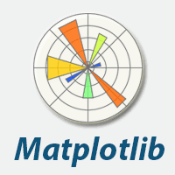
Visualizing data with Matplotlib and Seaborn
Matplotlib
This popular library for creating
static visualizations in Python.
It offers a wide range of customization
options and can be used to create a
variety of charts and graphs, including
line charts, bar charts, and scatter plots
and create a wide variety of visualizations
including line charts, scatter plots,
and histograms.

Slide 8
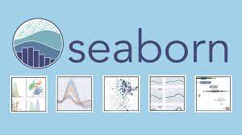
Seaborn
Seaborn, on the other hand,
is a library that is built on top
of Matplotlib and offers more
advanced features for statistical
analysis. It is particularly useful for
creating heatmaps, violin plots, and
other complex visualizations.

Slide 9
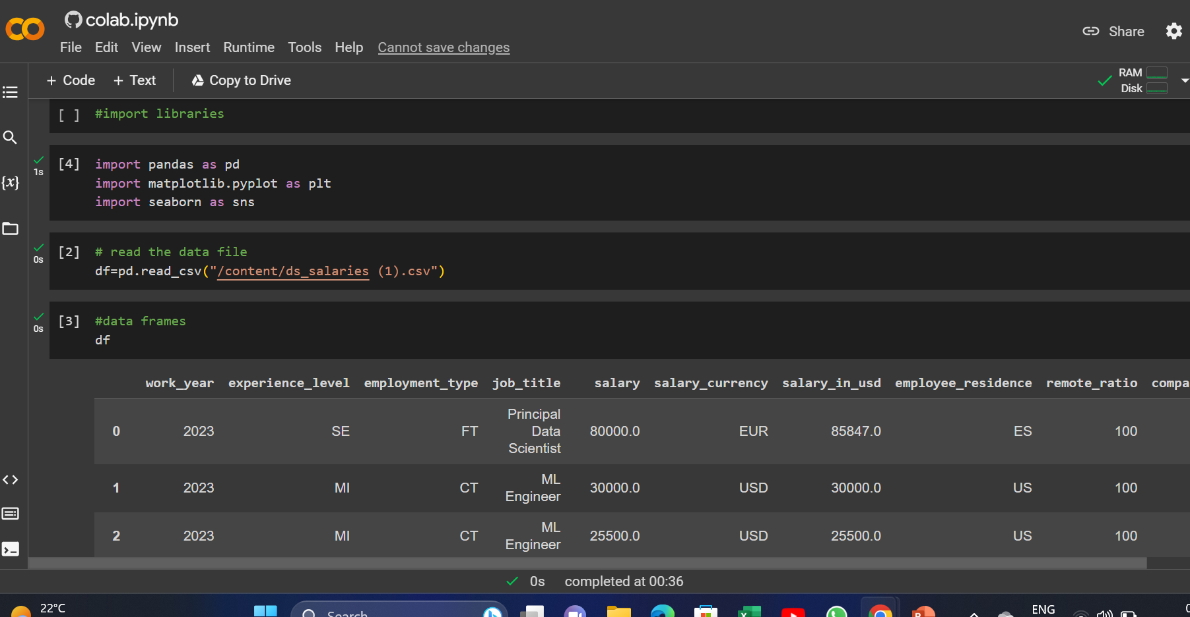
Importing the libraries and reading csv files

Slide 10
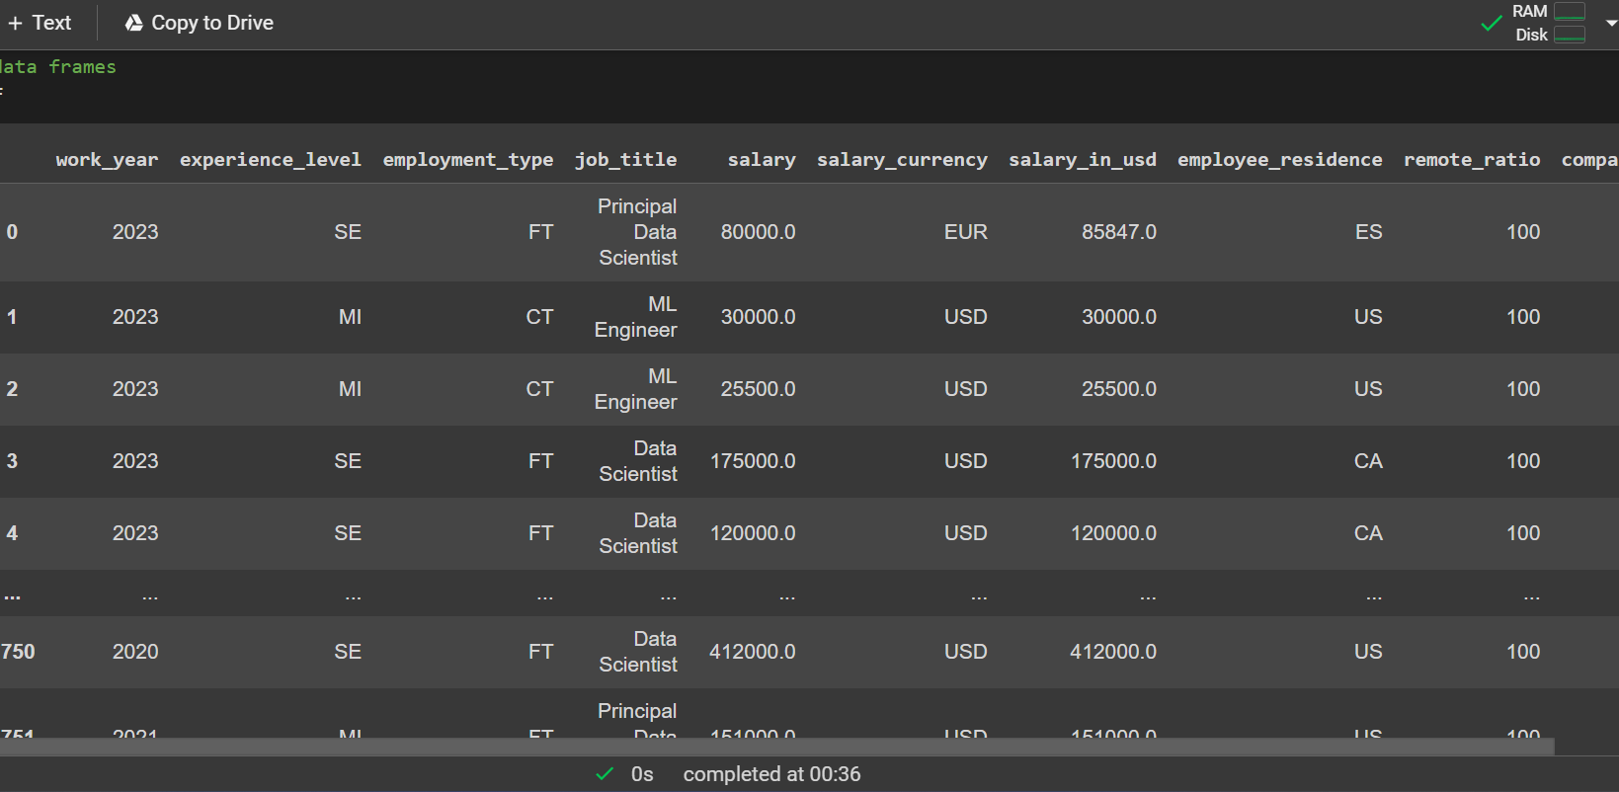
Data set

Slide 11
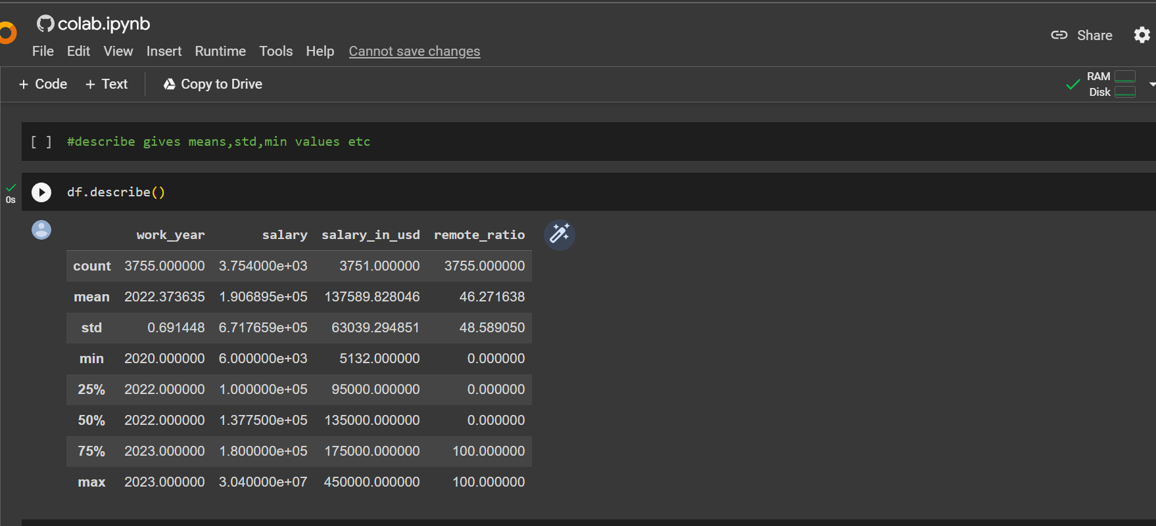
Describing about the data

Slide 12
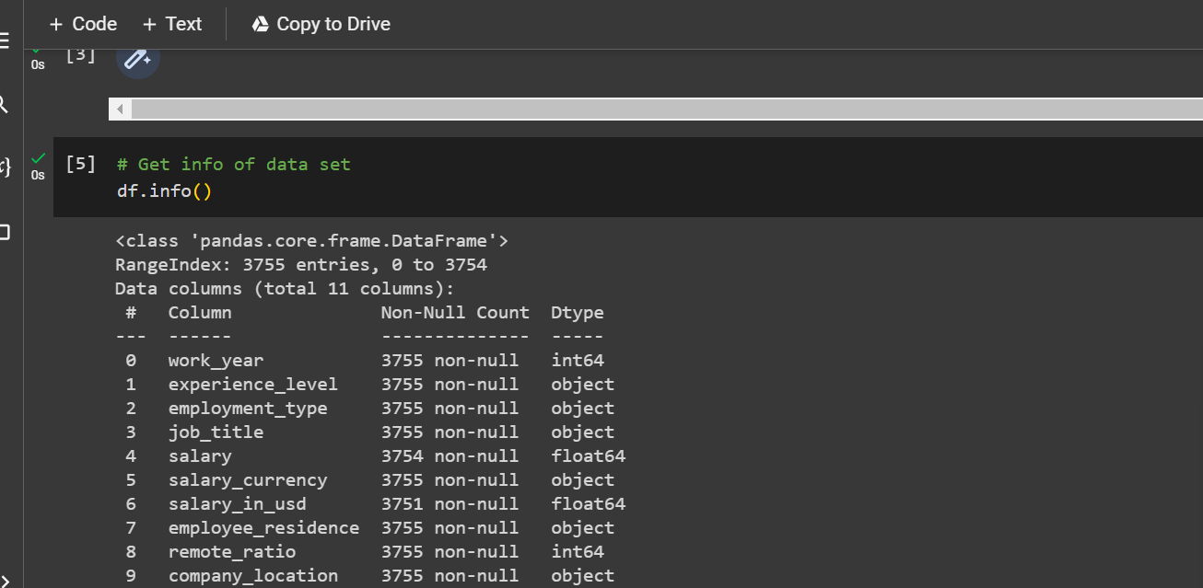
Infomation of data set

Slide 13
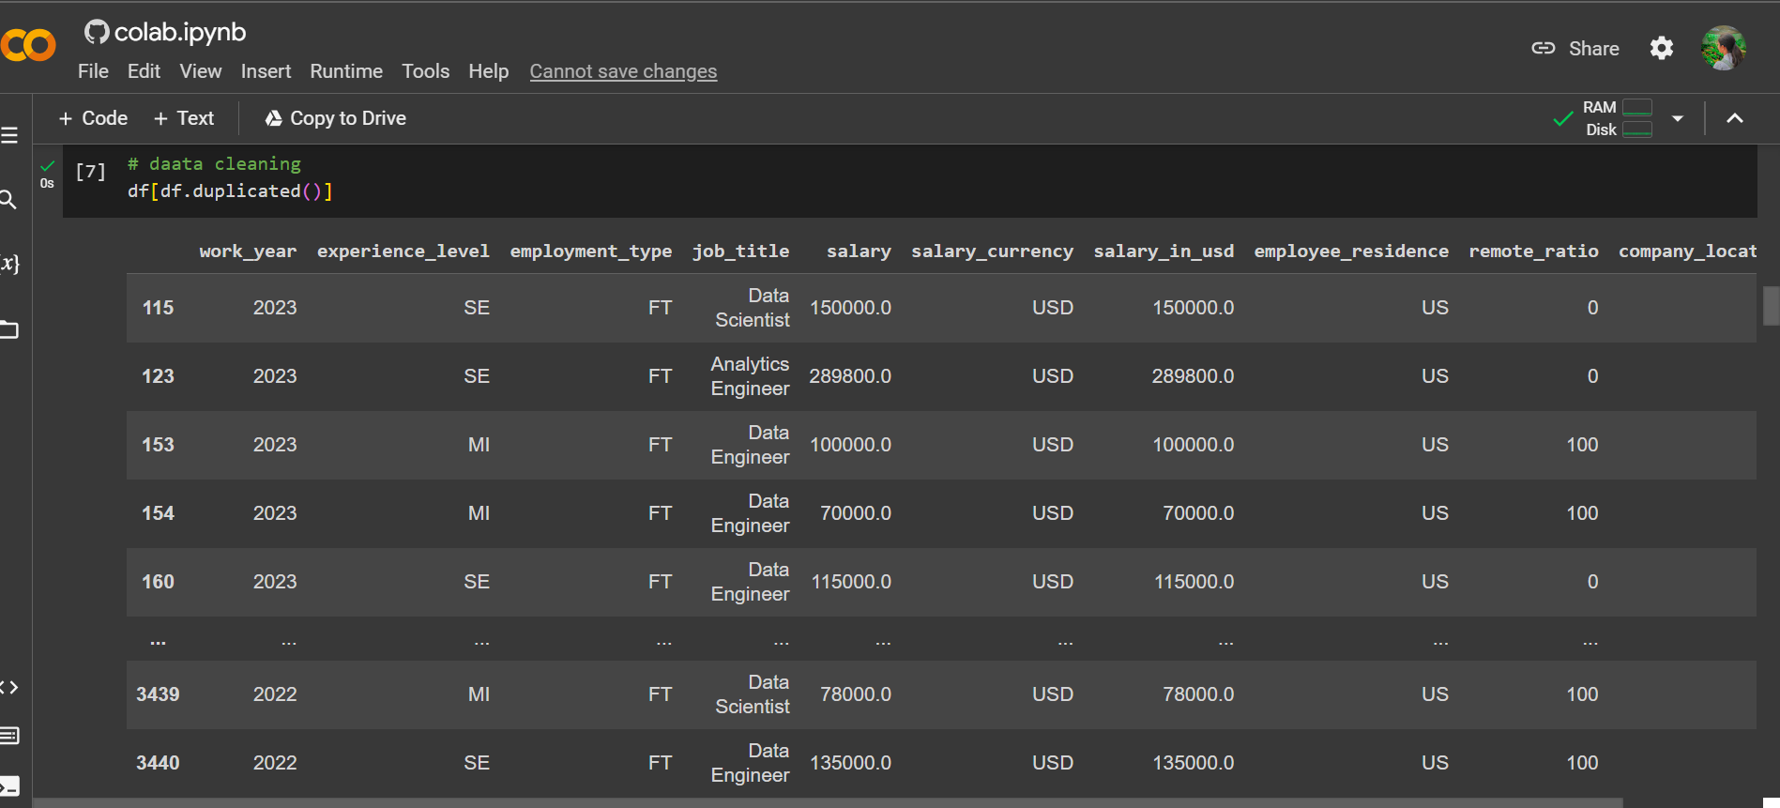
Cleaning process

Slide 14
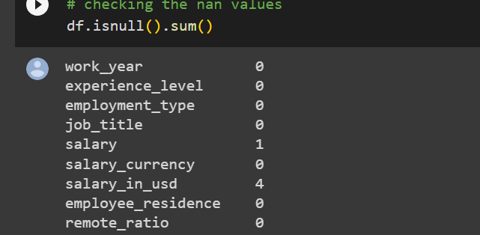
Checking null values

Slide 15
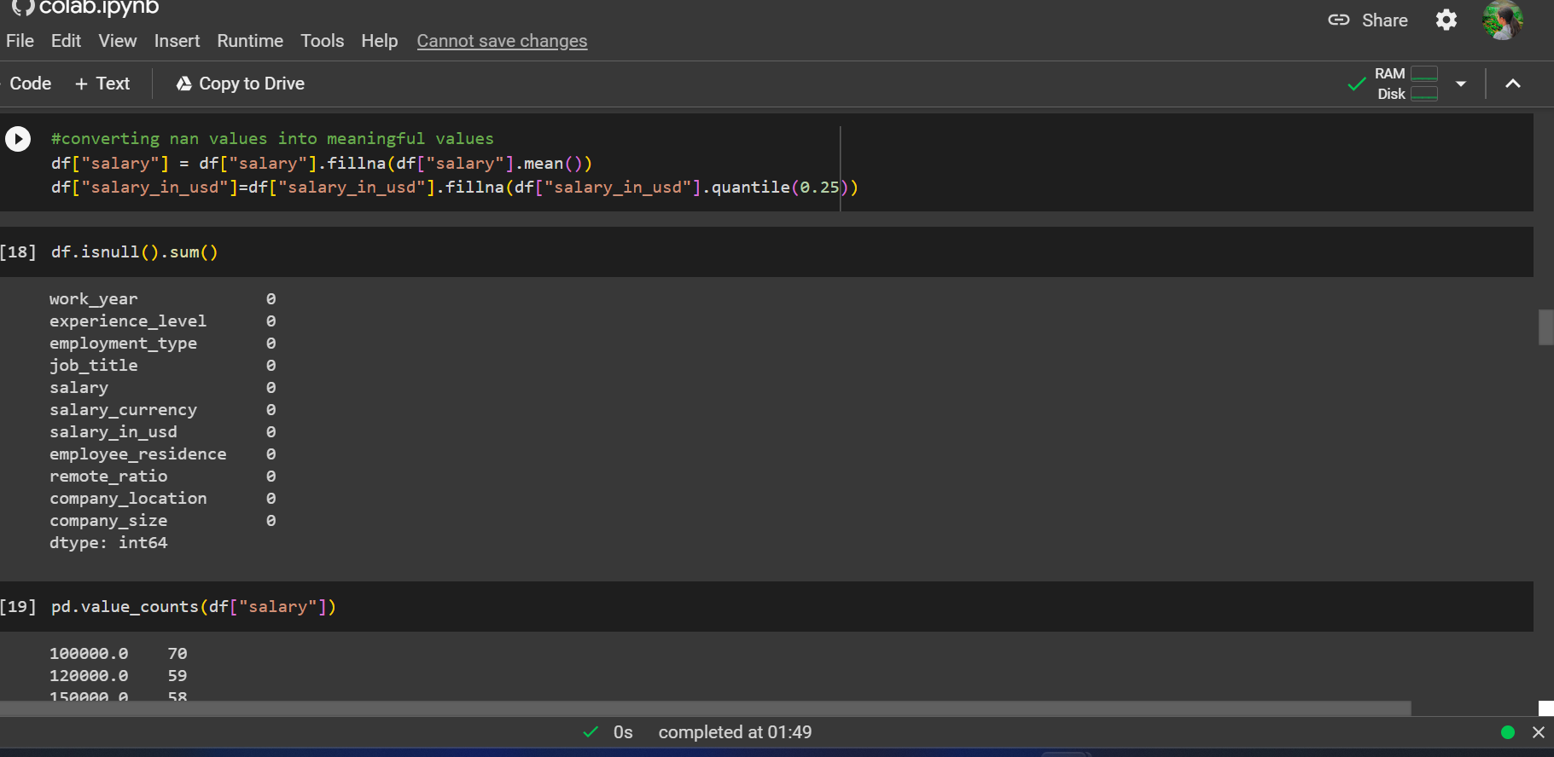
Converting null to values

Slide 16
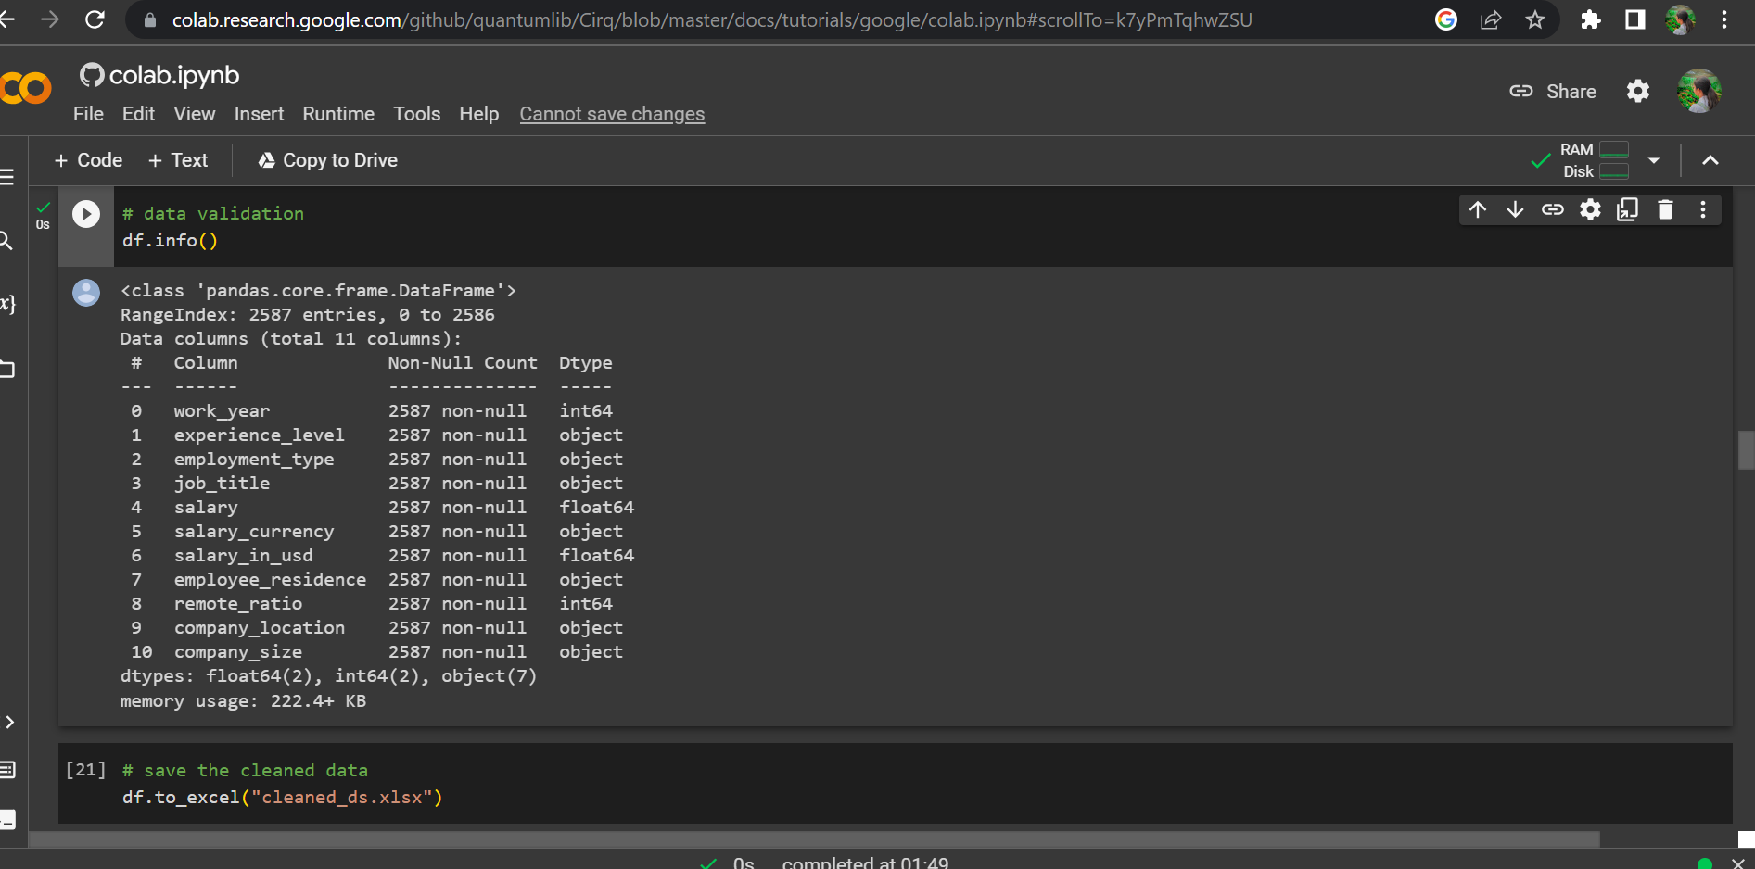
Save the data

Slide 17
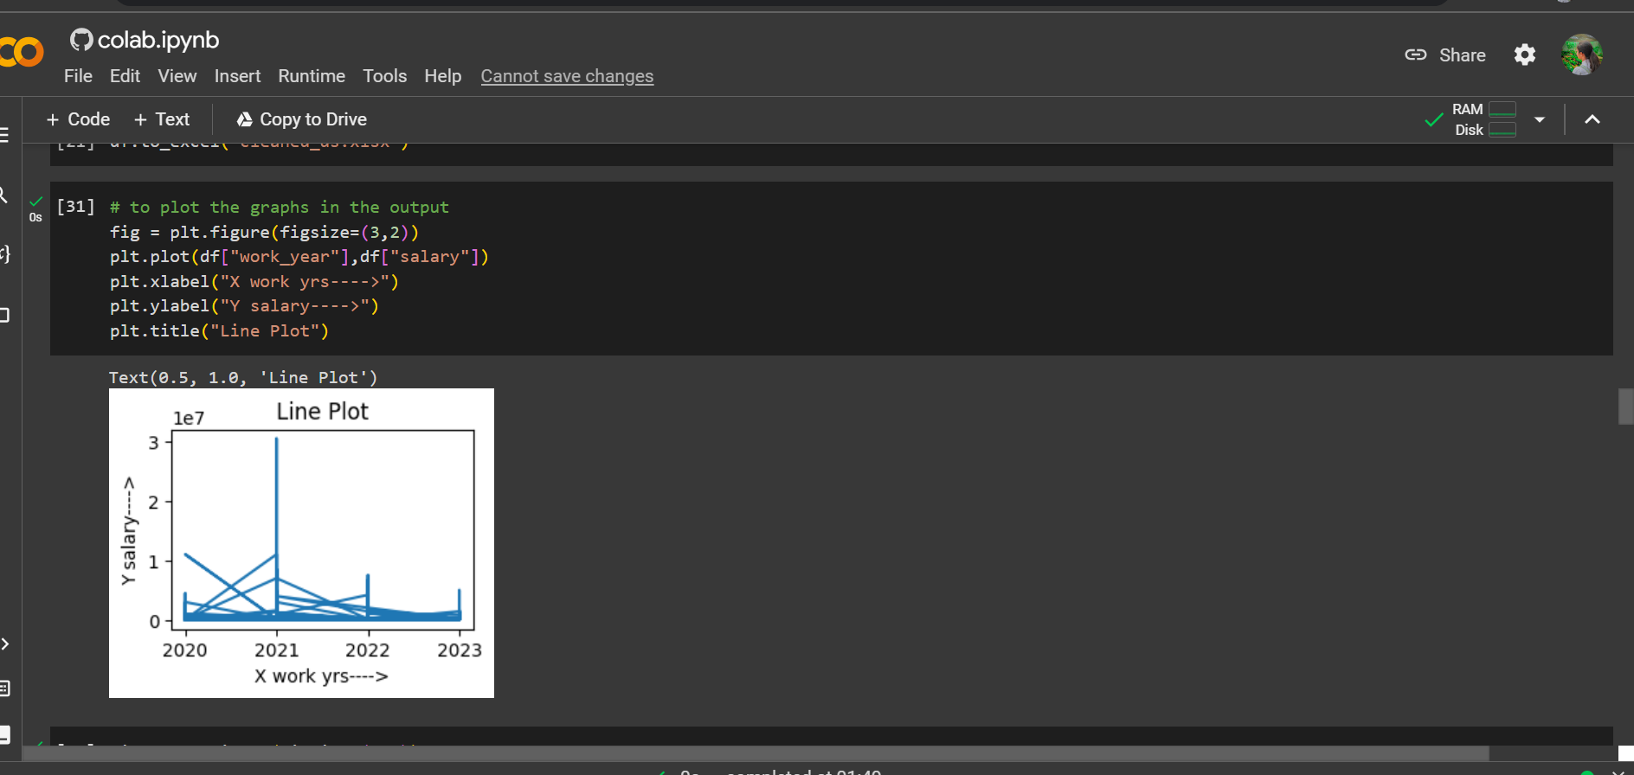
Line plot

Slide 18
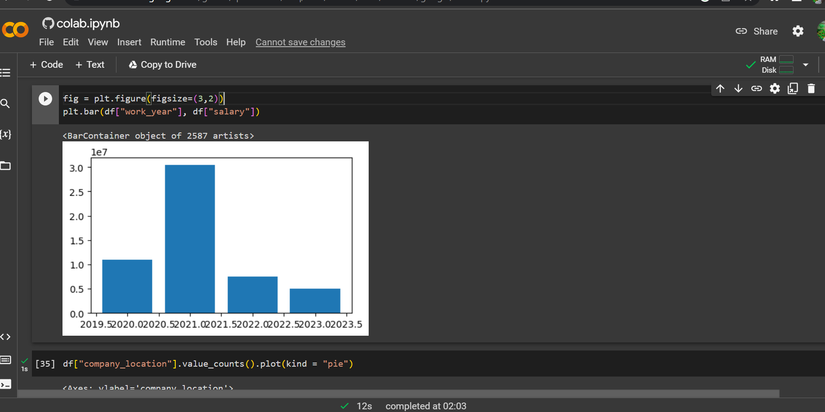
Bar plot

Slide 19
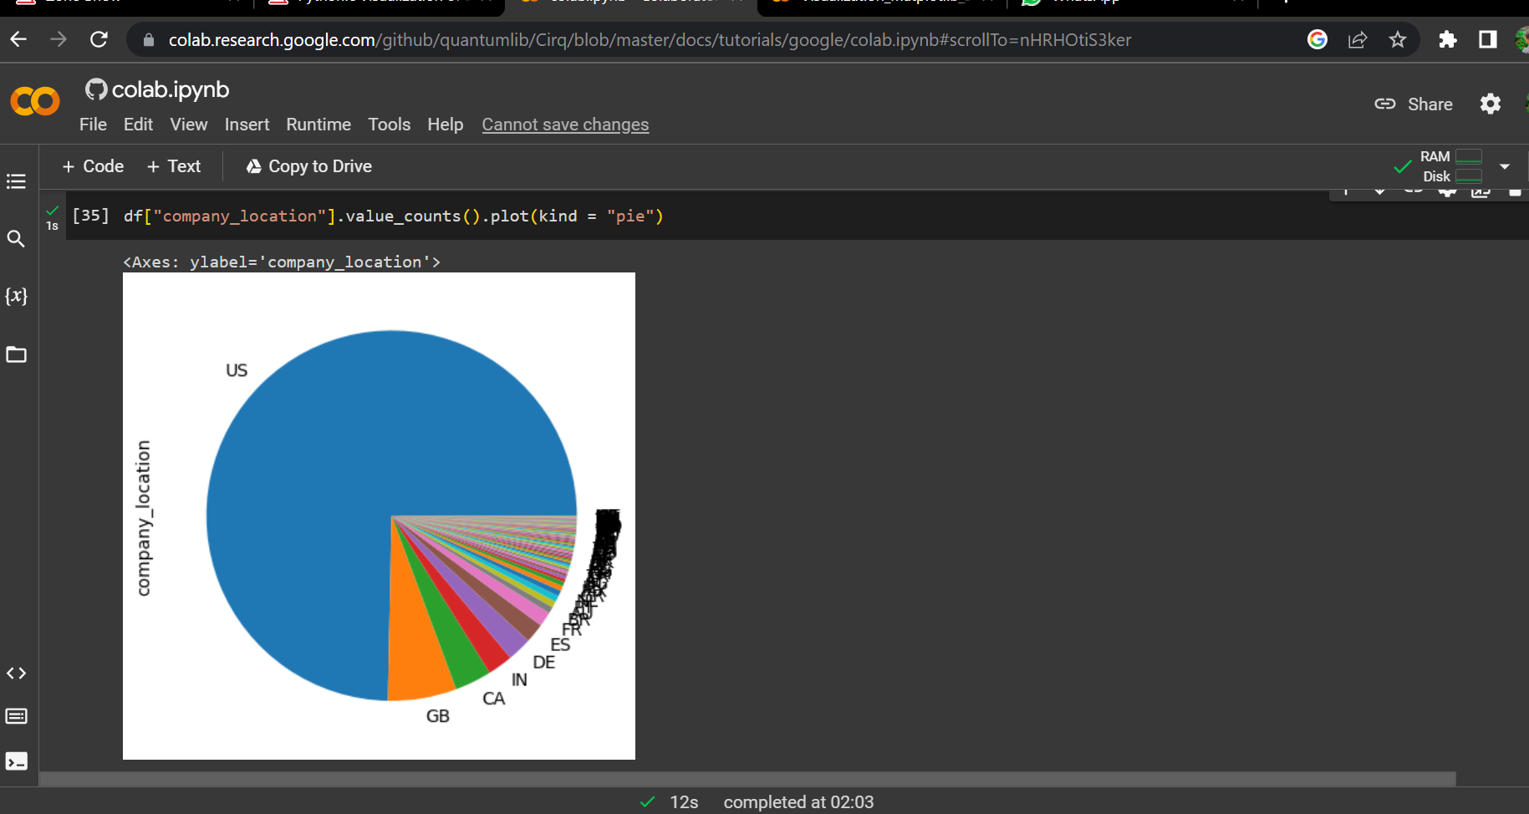
pie plot

Slide 20
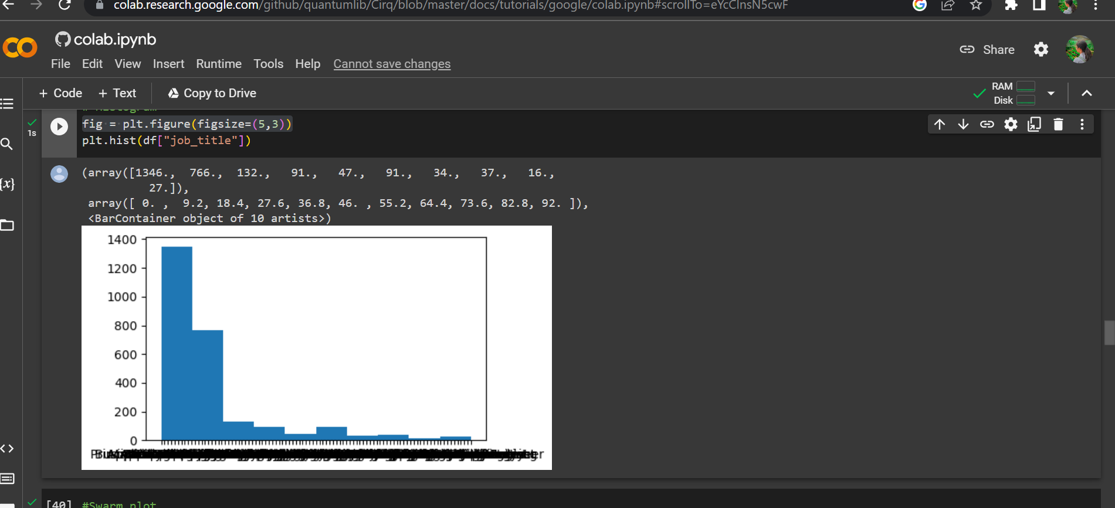
histogram

Slide 21
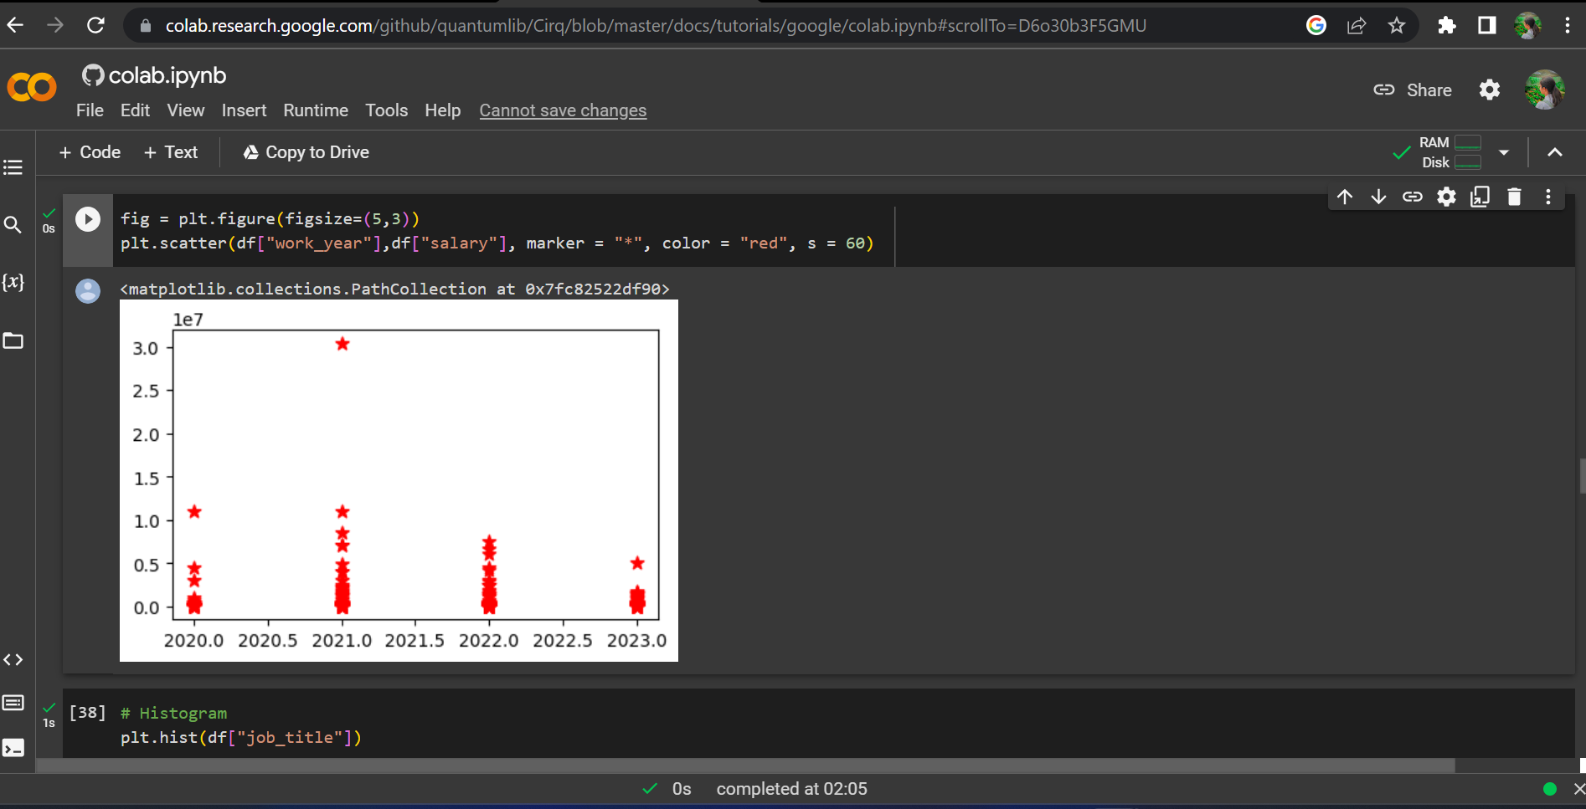
Scatter plot

Slide 22
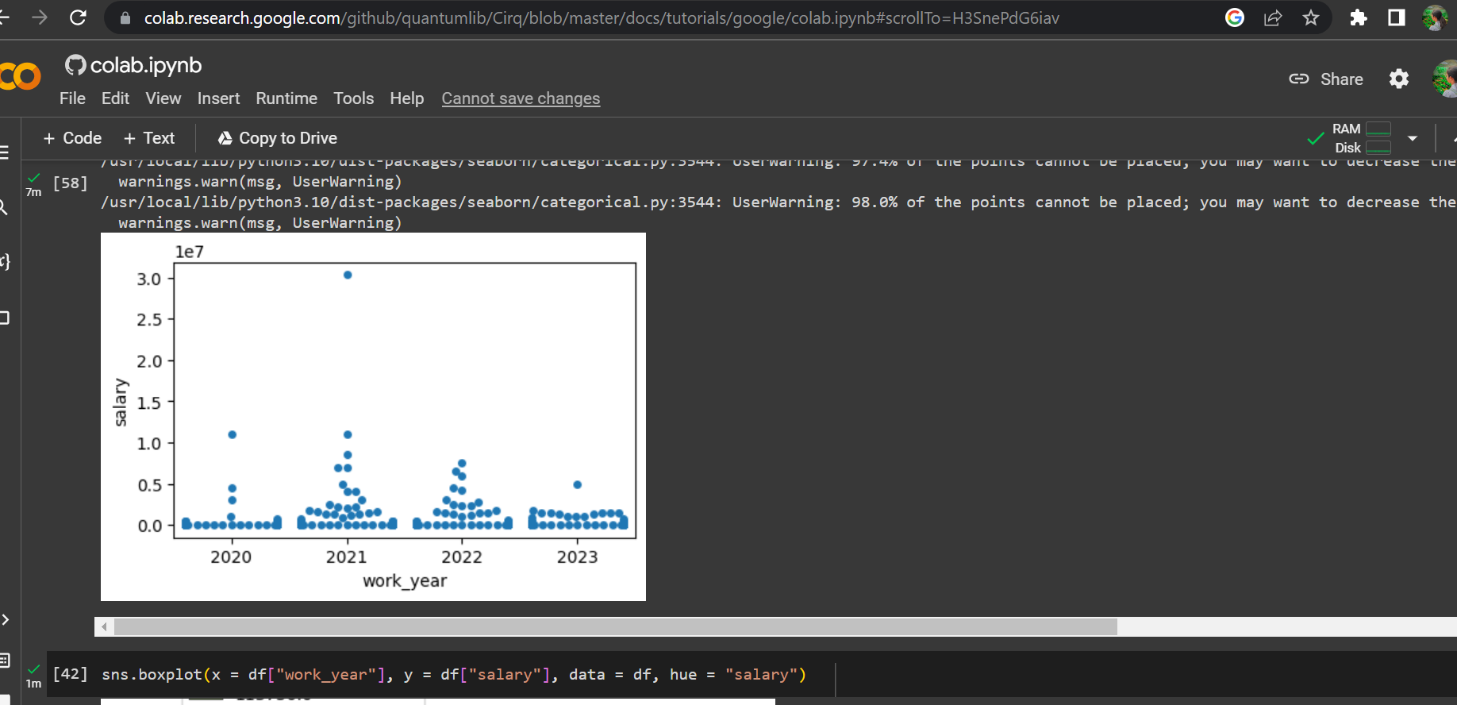
Swam plot

Slide 23
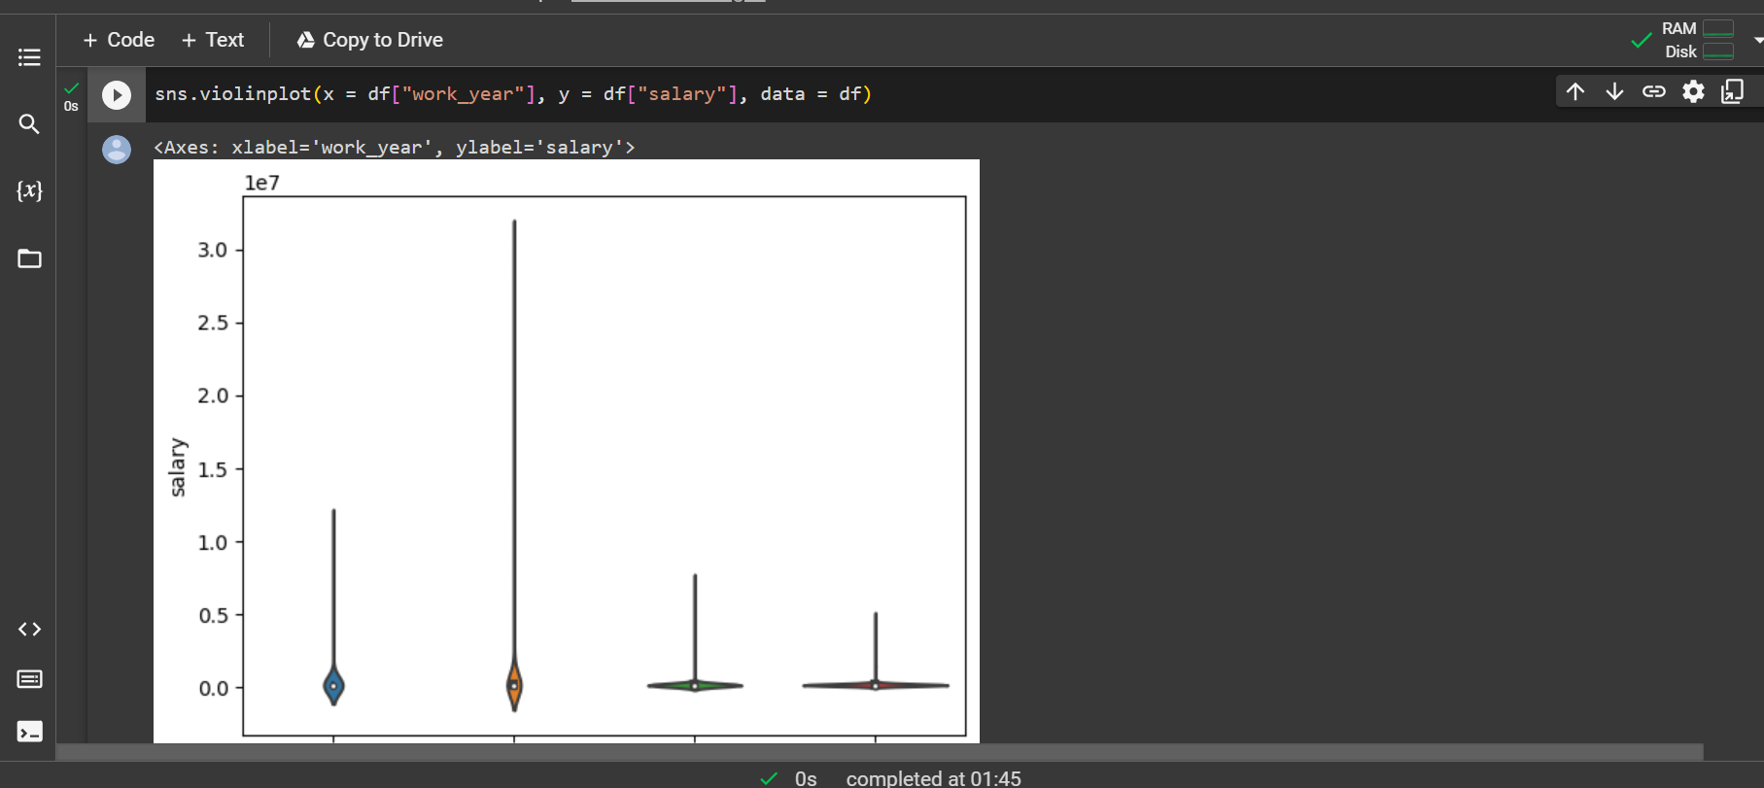
violinplot

Slide 24
Conclusion
In conclusion, visualizing data scientist salaries using Python libraries is crucial for gaining insights into the industry and making informed decisions.By using Matplotlib and Seaborn, we can create powerful visualizations that help us understand trends and patterns in salary data.
Thank you

